Slide 1
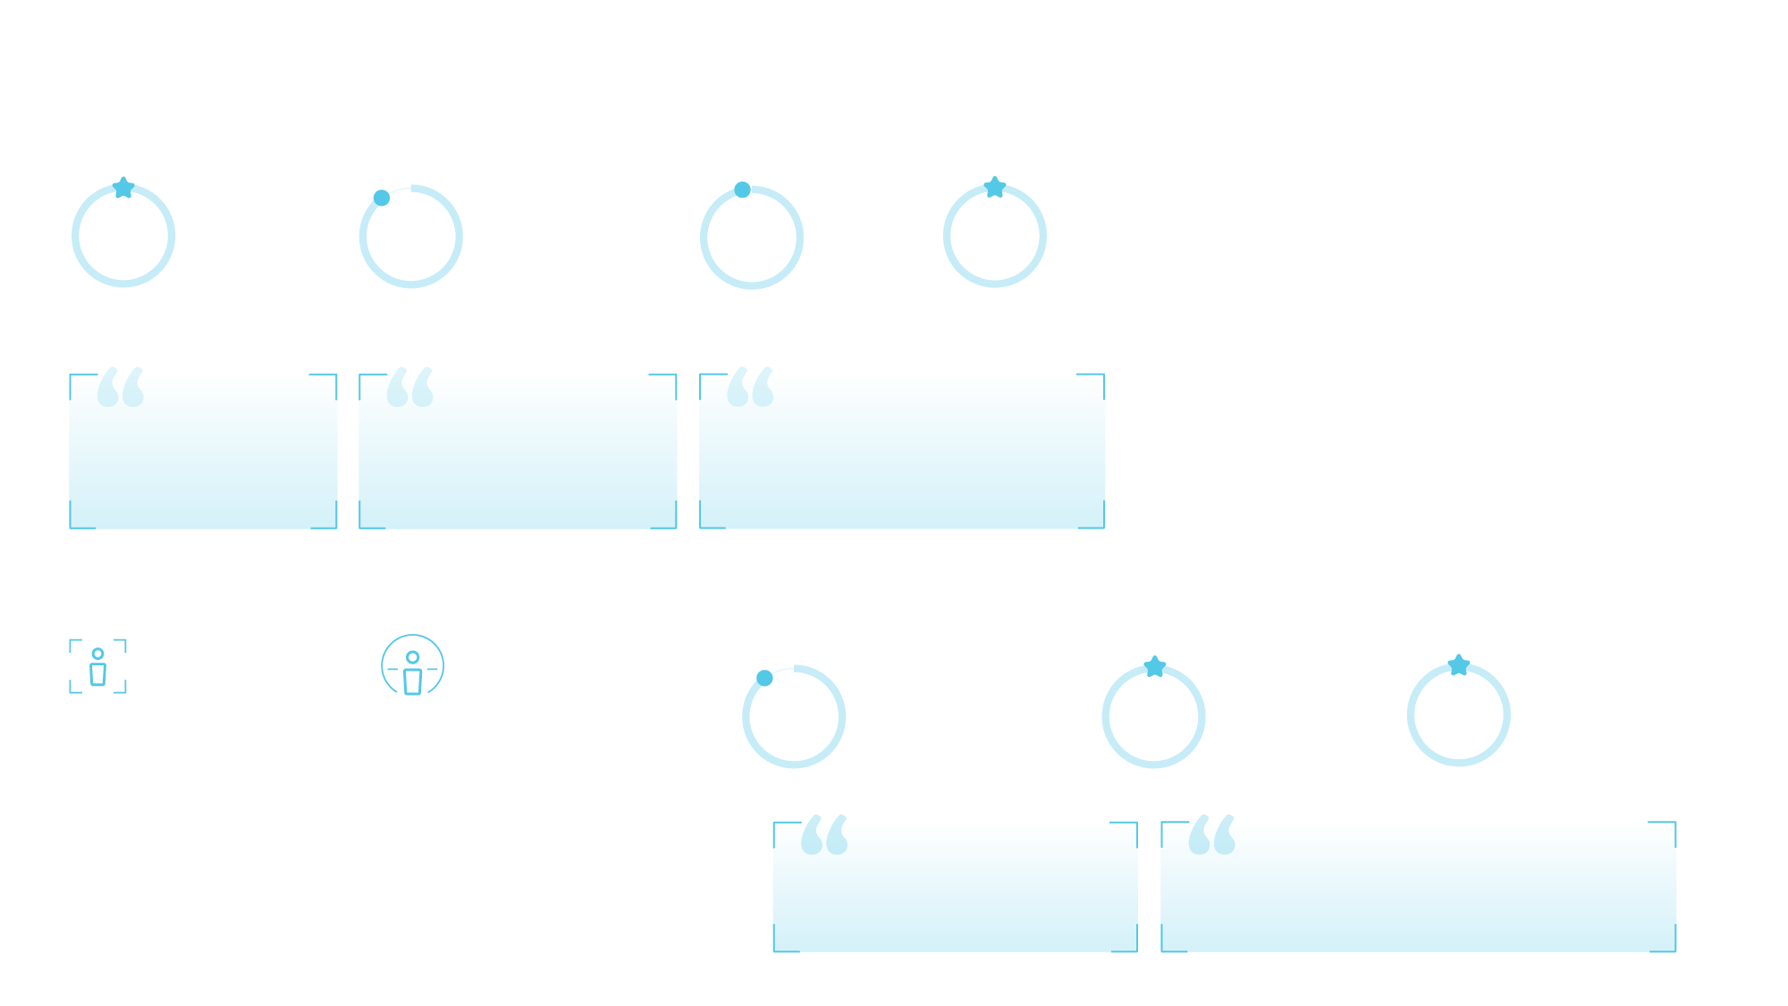
Revolution Ascend with Effortless Workflow Reduce the time and the resource to get to the right answer, every time
You have this piece of equipment with all this technology in it. Yet it pretty much runs itself.”
Gladys Farias, Manager Imaging Services, Baptist Health
What has improved is that as a result of that, the equipment has been adapted to make the radiographer’s daily work easier.”
Yann Castrec, CT technologist, Centre Hospitalier
This scanner with this new technology allows to gain significantly in image quality, to reduce significantly the patient dose for the patient and as a consequence, we have a more reliable diagnosis with this scanner.”
Alban Ganu, MD, Chief of Radiology, Center Hospitalier
66%
**
*
90%
56%
***
Reduction in clicks to execute a CT scan compared with legacy GE scanner
Protocol suggestion accuracy
Time saving for scan setting compared with legacy GE scanner
94%
21%
****
*****
Benefits of Effortless Workflow features as mentioned by the technologists…
OVERALL EXPERIENCE
INTELLIGENT PROTOCOL
• saving time in protocol selection
• standardization of protocols
AUTO POSITIONING
• saving time
• improving accuracy
• providing comfort for staff
• reducing patient dose
• reducing error in patient selection
SMART PLAN
faster scout planning
fewer scans without any edge cut or anatomical part too small
AUTO PRESCRIPTION
patient dose savings
providing better image quality
reducing manual work
Auto centering accuracy within +/- 2cm
Time saving for entire exam time compared with legacy GE scanner
91%
100%
100%
of technologists agree that Ascend led to a simplified scan experience.
of radiologists had a positive overall experience.
of radiologists would recommend Ascend to a colleague or friend.
High Efficiency
High Accuracy
High Throughput
* The required clicks are defined as clicks required to execute a scan from selecting a new patient till start scan. All associated clicks for and in clinical practice, number of the required clicks may vary depending on the circumstances, including but not limited to, the clinical task, exam type, clinical practice, and image reconstruction technique.
** Results may vary depending on the circumstances, including but not limited to, exam type, clinical practice. This analysis was performed on 3175 exams representing 17 different exam descriptions, collected from 4 different medical evaluation site.
*** The data was based on comparison between GE’s legacy products (16ch and 64ch scanner) and Revolution Ascend in the three institutions using a pilot product and selected routine head and body. The data set of this comparison was 838 exams for legacy products and 1387 exams for Revolution Ascend. The time saving value may not be effective for all institutions depending on the clinical practice. Defined the scan setting time is from “Open new patient” to “Confirm setting for Scout”
**** Measured centering accuracy which was scanned 921 standard routine exams in head and body with Auto positioning in the three institutions using a pilot product
***** The data was based on comparison between GE’s legacy products (16ch and 64ch scanner) and Revolution Ascend in the three institutions using a pilot product, and selected routine head and body. The data set of this comparison was 838 exams for legacy products and 1387 exams for Revolution Ascend.
The time saving value may not be effective for all institutions depending on the clinical practice. Definition of entire exam time is from “Open new patient” to “Last primary recon completed” for Revolution Ascend and “Close exam” for legacy products.
We were able to decrease the length of stay in 50% and we were able to improve outcomes.”
Ricardo Cury, MD Chairman of Radiology, Baptist Health
Having the Ascend made a world of difference and made our patient delay go from 5-6 hours in our emergency department to 2-3 hours.”
Gladys Farias, Manager Imaging Services, Baptist Health
Revolution Ascend

